Slide 1
Chapter 1
Introduction

Slide 2
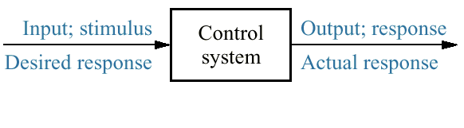
Figure 1.1
Simplified description
of a control system

Slide 3
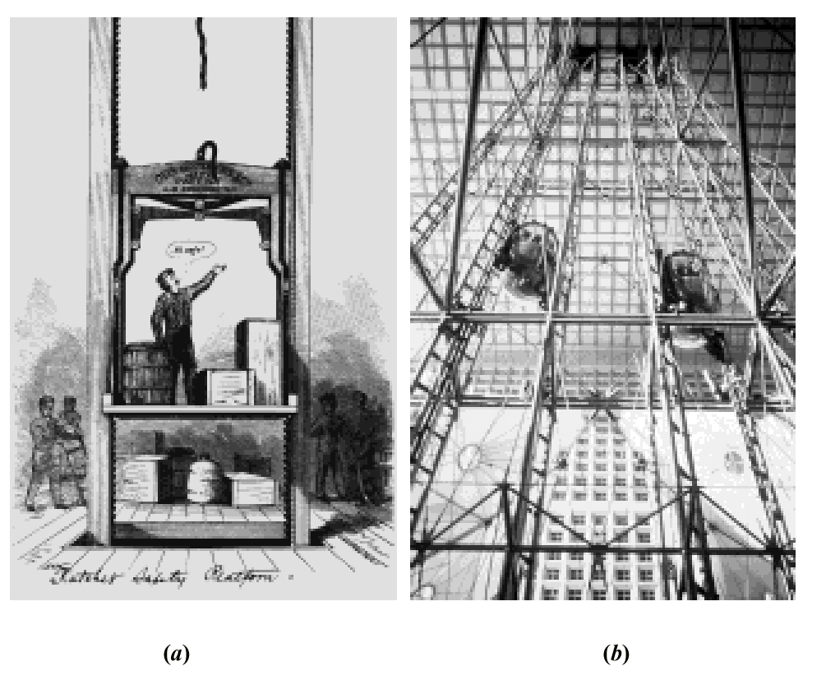
Figure 1.2
a. Early elevators
were controlled by
hand ropes or an
elevator operator.
Here, a rope is cut
to demonstrate the
safety brake, an
innovation in early
elevators;
b. Modern Duo-lift
elevators make
their way up the
Grande Arche in
Paris, driven by one
motor, with each car
counterbalancing the
other. Today, elevators
are fully automatic,
using control systems
to regulate position
and velocity.

Slide 4
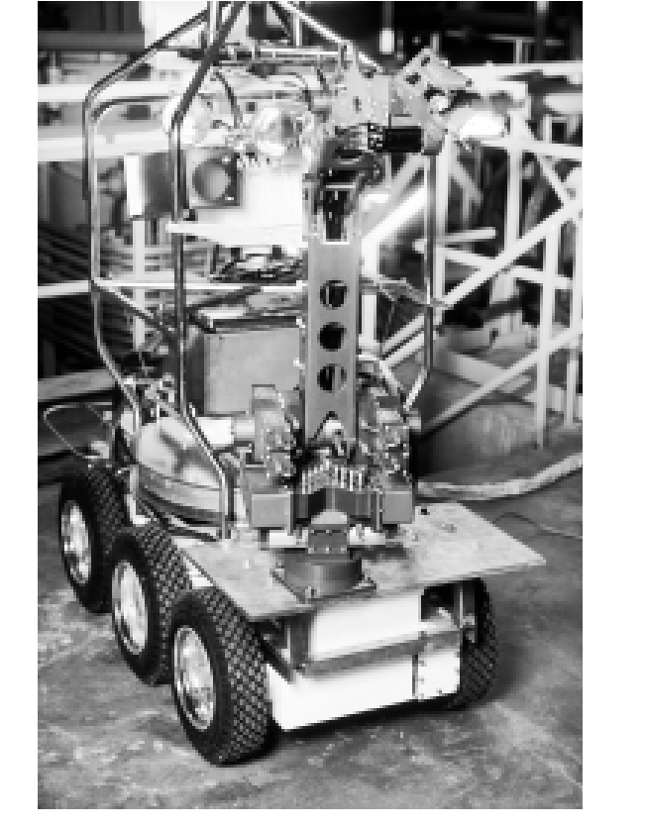
Figure 1.3
Rover was built to
work in contaminated
areas at Three Mile
Island in Middleton,
PA, where a nuclear
accident occurred in
1979. The remote
controlled robot’s
long arm can be seen
at the front of the
vehicle.

Slide 5
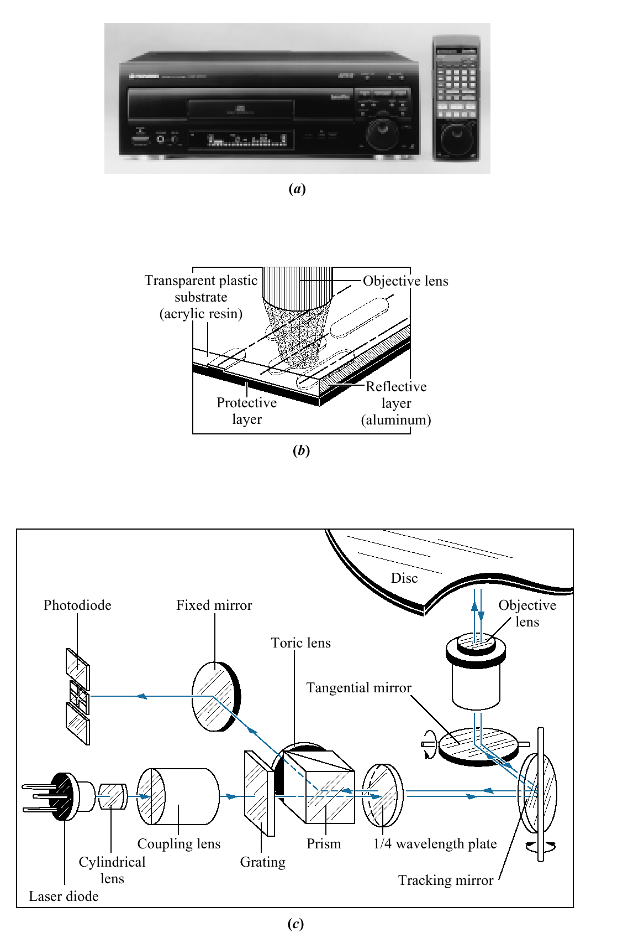
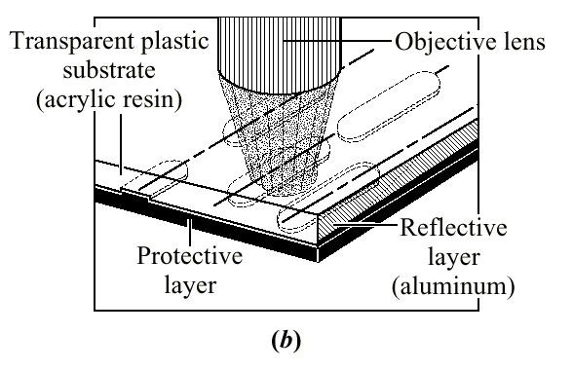
Figure 1.4
a. Video laser disc
player;
b. objective lens
reading pits on a
laser disc;
c. optical path for
playback showing
tracking mirror rotated
by a control system to
keep the laser beam
positioned on the pits.
(a)
(b)
(c)

Slide 6
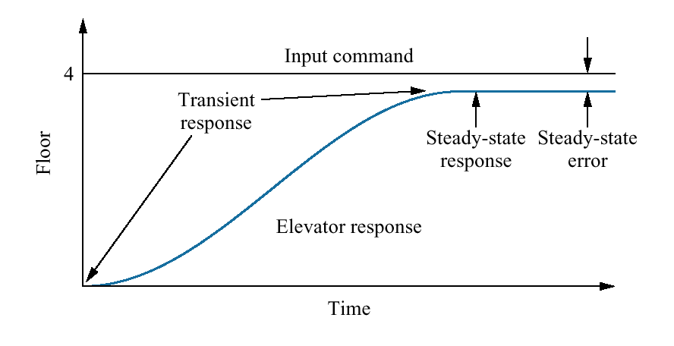
Figure 1.5
Elevator input and
output

Slide 7
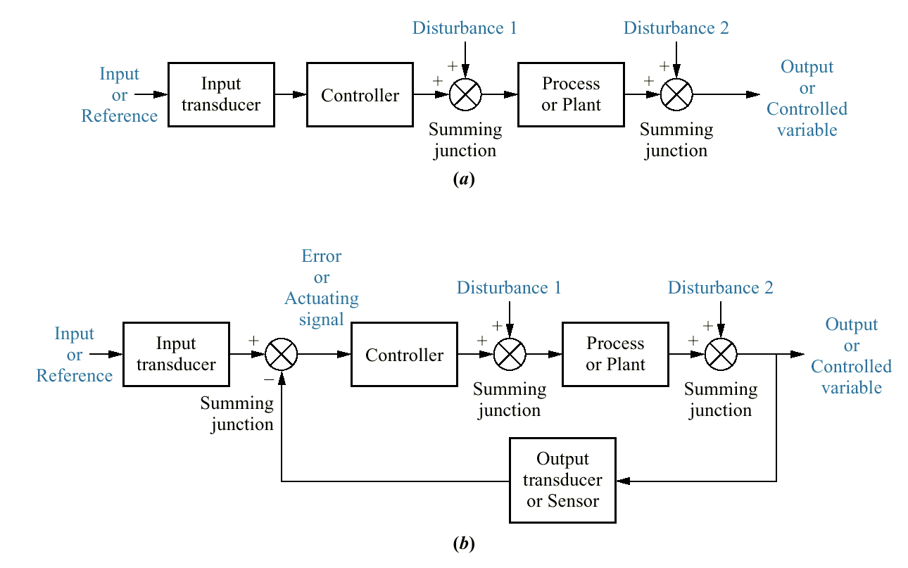
Figure 1.6
Block diagrams
of
control systems:
a. open-loop system;
b. closed-loop system

Slide 8
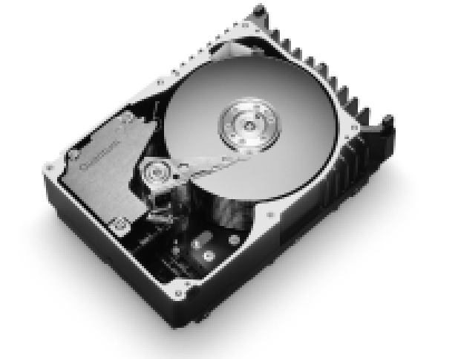
Figure 1.7
Computer hard disk
drive, showing disks
and read/write head

Slide 9
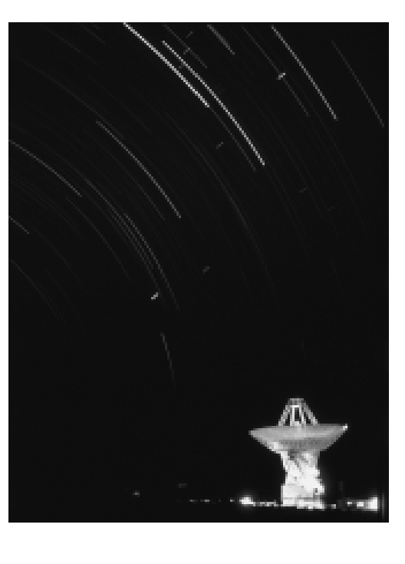
Figure 1.8
The search for
extraterrestrial life is
being carried out with
radio antennas like the
one pictured here. A
radio antenna is an
example of a system
with position controls.

Slide 10
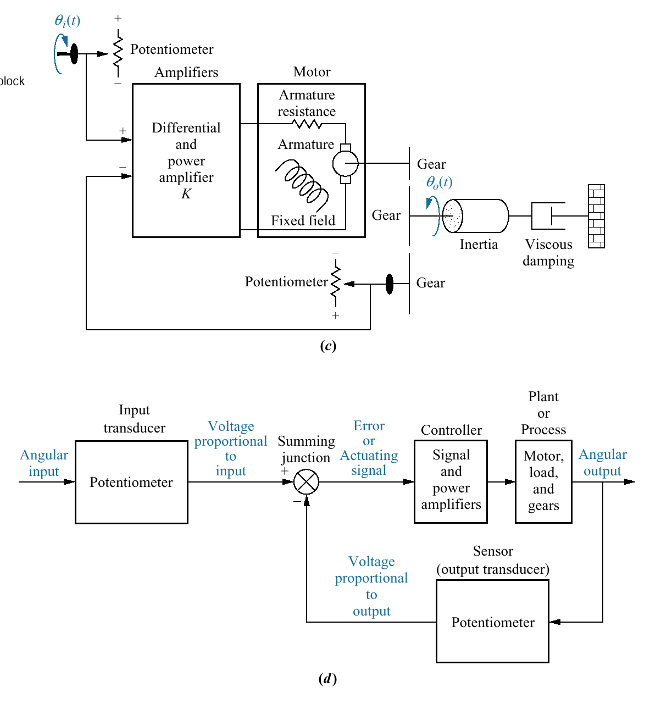
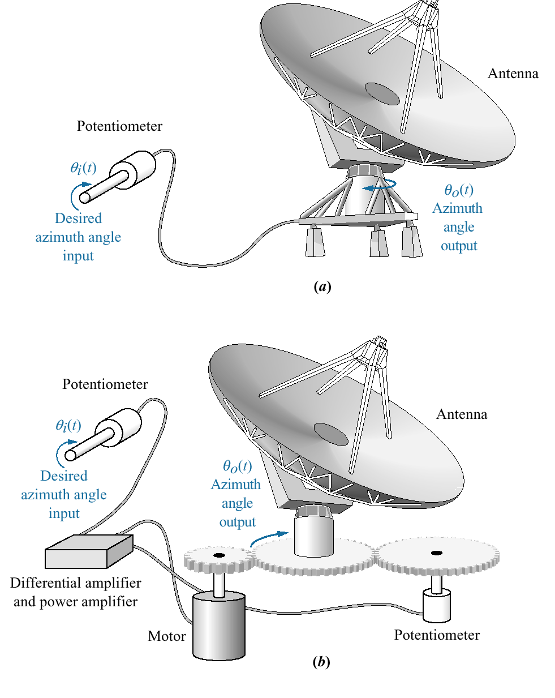
Figure 1.9
Antenna azimuth position
control system:
a. system concept;
b. detailed layout;
c. schematic;
d. functional block diagram

Slide 11
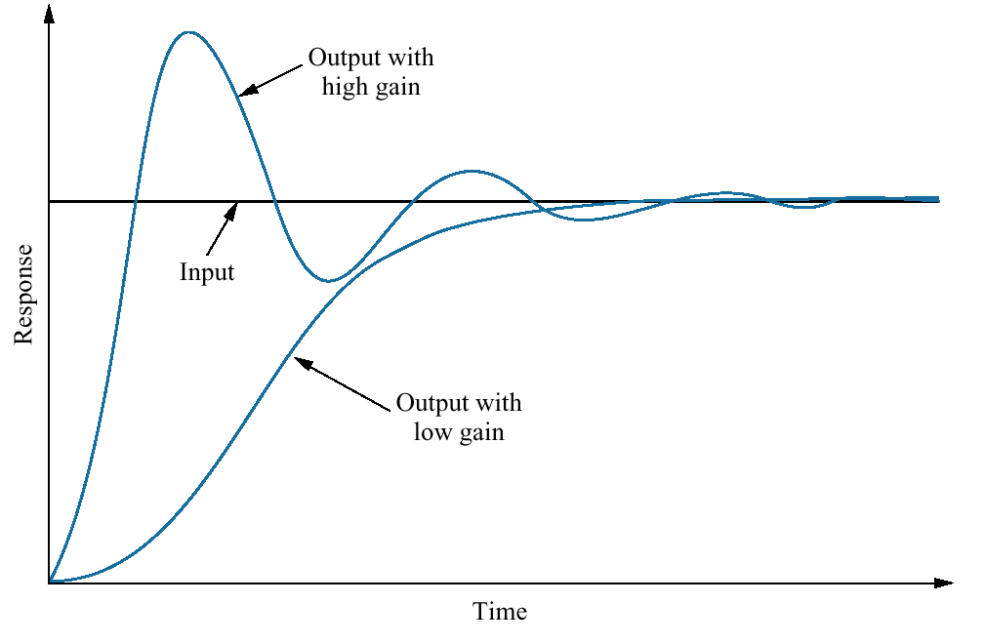
Figure 1.10
Response of a position
control system
showing effect of high
and low controller
gain on the output
response

Slide 12
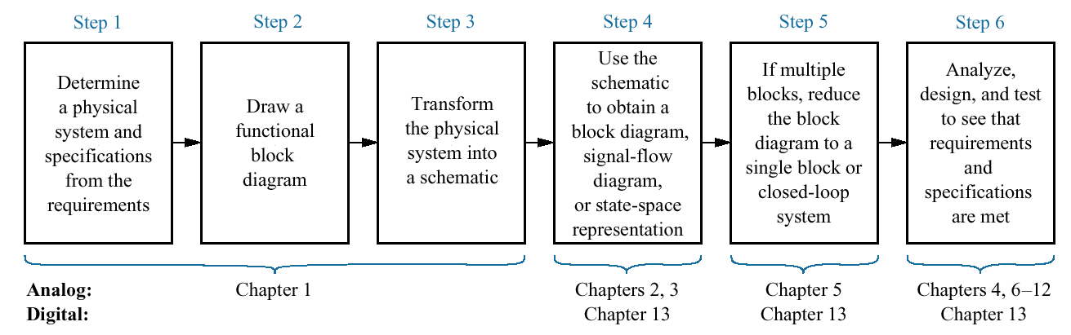
Figure 1.11
The control system
design process

Slide 13
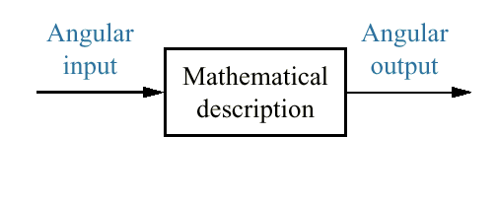
Figure 1.12
Equivalent block
diagram for the
antenna azimuth
position control
system

Slide 14
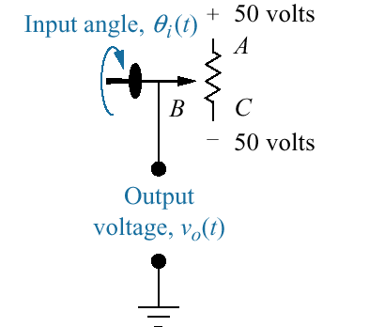
Figure P1.1
Potentiometer

Slide 15
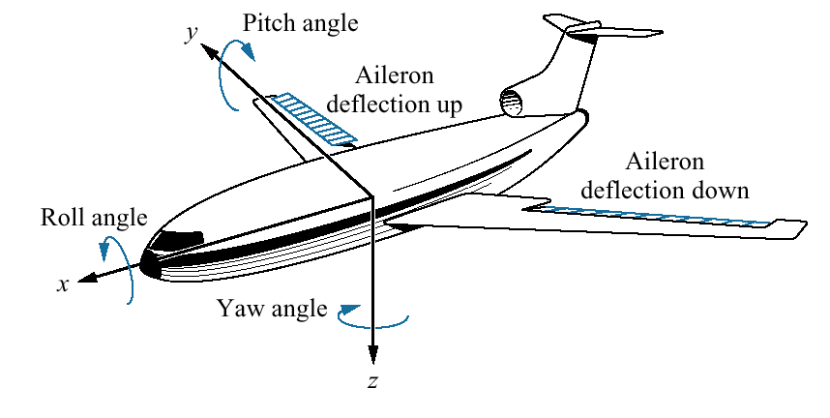
Figure P1.2
Aircraft attitude
defined

Slide 16
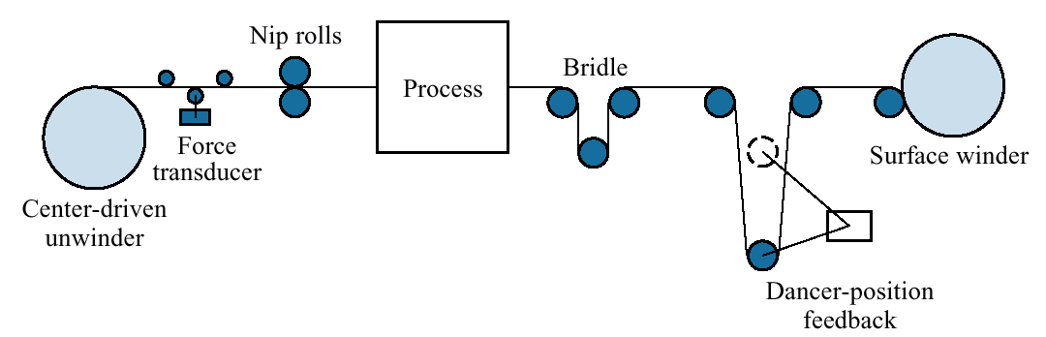
Figure P1.3
Winder

Slide 17
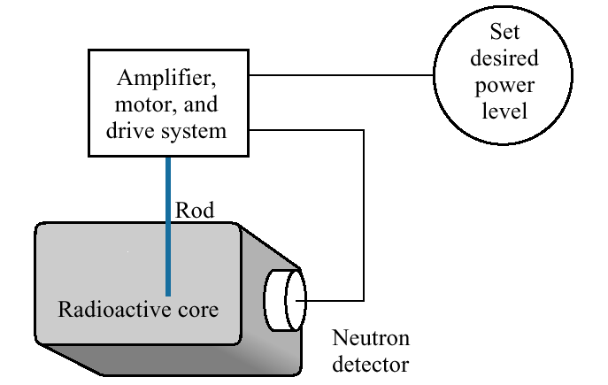
Figure P1.4
Control of a nuclear
reactor

Slide 18
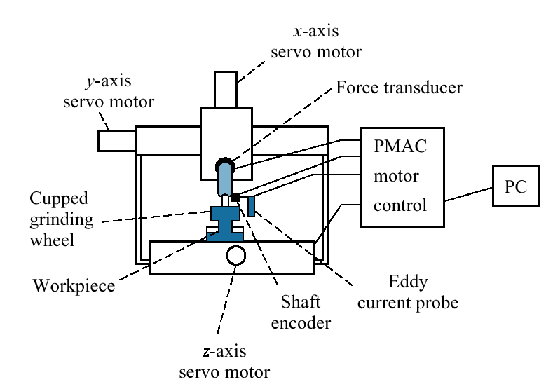
Fig P1.5
Grinder system

Slide 19
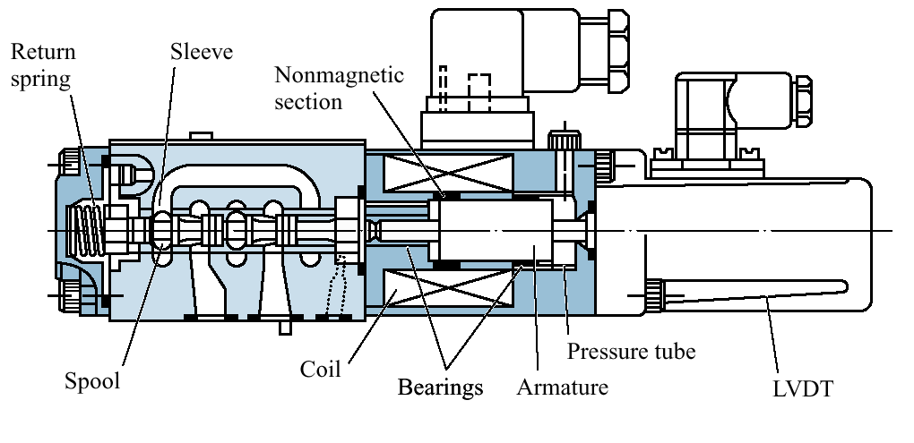
Figure P1.6
High-speed
proportional
solenoid valve

Slide 20
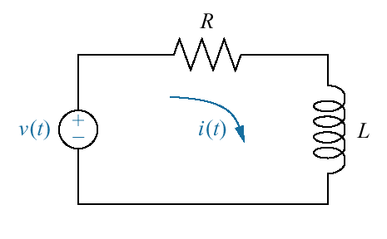
Figure P1.7
RL network

Slide 21
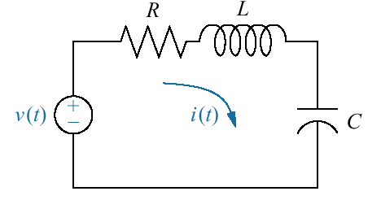
Figure P1.8
RLC network

Slide 22
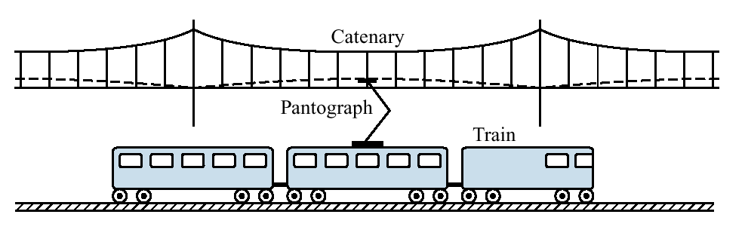
Figure P1.9
High-speed rail system
showing pantograph
and catenary

